Slide 1

Enhancing the Educational Experience for Deaf and Hard of Hearing Students in Software Engineering
Daniel E. Krutz, Jayme A. Kaplan, Scott D. Jones, Samuel A Malachowsky
Rochester Institute of Technology - Software Engineering

Slide 2
Problem Statement
Software Engineering is communication driven
Communication differences = communication barriers
Many educators & students are not familiar with best practices for education deaf/HoH

Slide 3
Communication in SE
Inter-team communication
Discuss design/modeling etc… decisions
Project status
Many more….
Extra-team communication
Gather requirements
Share project status

Slide 4
SE Education
9-22 /1,000 people have severe hearing impairment
Most students & instructions are not prepared to work with deaf/HoH students
Deaf/HoH students only comprehend 50-80% of communication through interpreters
Hearing students 85-95% comprehension
Students with disabilities are far less likely to pursue careers in computing & engineering
High dropout rates
Notes:
Give a background for deaf/HoH individuals and the state of education.
College-Age Population: 3.4% Deaf/HoH
RIT: 1,550/15,400 : 10% Deaf/HoH

Slide 5
RIT SE & NTID
National Technical Institute for the Deaf
1st and largest technical college in world for deaf/HoH
~1,500 students (~15,000 students at RIT)
RIT Software Engineering
1st SE program in US
Most classes have team-oriented projects
Notes:
Give a background of NTID & RIT

Slide 6
Related Work
Several works about teaching programming to deaf/HoH students
SE is not programming
How to increase participation for deaf/HoH
Recruiting students through disability programs
Use of E-Learning content
Extra courses to further acclimate deaf/HoH students
9 week summer program
Notes:
We wanted an SE focus (not programming) in existing courses (not additional courses)

Slide 7
Goals
Share our experiences
Create Best Practices guide for instructors
Discuss common mistakes in educating Deaf/HoH students
Discuss improvements to made, both at our institution and others
Lay the groundwork for future work in this area

Slide 8
Our Experiences
Even with a large amount of support staff & reasonably acclimated instructors and students, deaf/HoH students were
Anonymous survey
1st – 5th year students
Hearing students
Deaf/HoH Students
Faculty
Survey asked all groups to provide feedback on their experiences.

Slide 9
Our Study
Software Engineering Faculty
Speech Language Pathologist (SLP)
Questionnaires
Faculty
Hearing students
Deaf/HoH students
In person interviews

Slide 10
Deaf/HoH Feedback

Slide 11
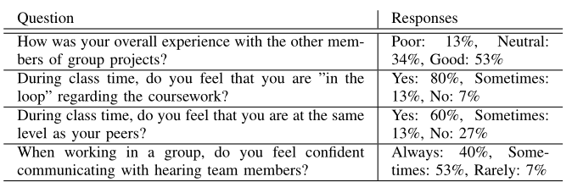
Deaf/Hoh Student Sample Questions

Slide 12
Deaf/Hoh Student Feedback
Deaf/HoH grew to expect some ignorance
Even at a place like RIT
Likely more profound at institutions with less deaf/HoH
Deaf/HoH felt viewed as a burden by hearing peers
Felt that it was hard to connect with their hearing peers
Isolated

Slide 13
Deaf/Hoh Student Feedback
Felt that Deaf/HoH students needed to speak up for themselves more
“I would recommend that they advocate for themselves as much as possible so as to ensure that they are included as much as possible in the team’s work”

Slide 14
Hearing Feedback

Slide 15
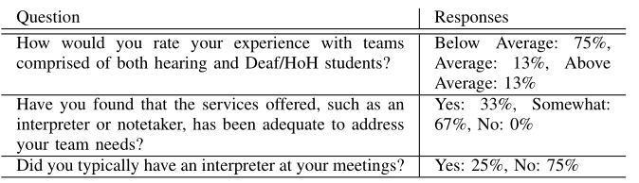
Hearing Feedback Sample Questions
Notes:
May relate to standard communication practices: i.e. deaf are more used to communicating with hearing than the other way around

Slide 16
Hearing Feedback
Cohesive environments are important for everyone
Felt communication barrier was large
Led to increased time spent in assignments
Made hearing students not want to work with deaf/HoH
Deaf/HoH students should better advocate for themselves

Slide 17
Hearing Feedback
Felt like Deaf/HoH would often choose not to contribute
75% of hearing students rated their interacts as below average
Didn’t like the extra time required to communicate & complete tasks
“My teammates and I ended up picking up the work the hard-of-hearing teammate would have completed because we did not want to fall behind on the project.”

Slide 18
Faculty Feedback

Slide 19
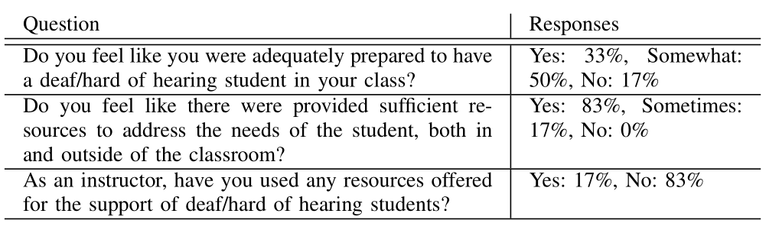
Faculty Feedback Sample Questions

Slide 20
Faculty Feedback
Felt like interpreters did well
Often made instructors rethink communication strategy
“Be sure to include the students in group activities, etc. Sometimes it can be hard to distinguish between barriers or issues caused by the disability and individual personality traits of the student.”

Slide 21
Interpreter Feedback

Slide 22
Interpreter Feedback
Three interpreters were interviewed
Felt that instructors were not prepared/ignorant of how to instructor Deaf/HoH students
About the culture in general
Recommended a required workshop for new faculty
“Have the same expectations of Deaf/HoH students as you would anyone else. If extra time is needed on tests, follow that procedure (or any other accommodations listed). CC [closed caption] any video used. Don’t speak to the board while lecturing, your other students will appreciate that too.”

Slide 23
Interpreter Feedback
“Have the same expectations of Deaf/HoH students as you would anyone else. If extra time is needed on tests, follow that procedure (or any other accommodations listed). CC [closed caption] any video used. Don’t speak to the board while lecturing, your other students will appreciate that too.”

Slide 24
Recommendations

Slide 25
Recommendations - Instructors
When speaking with a Deaf/HoH individual, look at and speak to the individual not toward the interpreter. Speak clearly and naturally
Keep sightlines open and clear from obstruction — seeing the speaker’s face is important for speechreading (lipreading) and nonverbal communication such as facial expressions
Clarify/repeat messages and/or give examples. Allow for repetition of information, do not say “never mind” if the information was missed

Slide 26
Recommendations- Hearing Students
Determine which access and support services will be most useful for you to utilize. Use them to support your work in lecture and group work
Notify the professor of any and all services you are using and how they can support these services to the best of their abilities
Inform the interpreter if you do not understand their signing, a term presented, or parts of the material

Slide 27
Recommendations – Deaf/HoH Students
Technology-based departments should work more closely with the interpreters and the interpreting department to support terminology development for courses that contain jargon central to the subject
Find better more user-friendly strategies for students in mixed hearing status groups, with the goal of allowing them to communicate freely and effectively

Slide 28
Limitations
Software Engineering programs represent a minority of computing programs.
There is no one size fits all solution
Only surveyed a relatively small portion of students
Like with all people, deaf/HoH are all different
Different hearing & sign levels
Different preferences
Different resources available

Slide 29
Future Work
Expand to other computing programs
Include deaf/HoH instructors
Could not find any for our analysis
Survey more students at other institutions

Slide 30
Conclusion
While there is no silver bullet, there are best practices.
Encourage deaf/HoH to take active leadership roles
Encourage communication
.. Make it a key component/requirement
Removing ignorance is key
How to properly communicate
Best practices
Culture
Apparent even at RIT
Need for technically skilled interpreters

Slide 31
Thanks… Questions?
Samuel A Malachowsky
Rochester Institute
of Technology
Software Engineering
samvse@rit.edu
TeachingSE.com
Daniel E Krutz
Rochester Institute
of Technology
Software Engineering
dxkvse@rit.edu
se.rit.edu/~dkrutz
Jayme Kaplan
Rochester School
for the Deaf
Jayme.Kaplan@gmail.com

Slide 32
Thanks… Questions?
Samuel A Malachowsky
Rochester Institute
of Technology
Software Engineering
samvse@rit.edu
TeachingSE.com
Notes:
Jayme.Kaplan@gmail.com
Rochester School for the Deaf

